Slide 1
Solving Problem by Searching : Uninformed Search
Course Code: CSC4226
Course Title: Artificial Intelligence and Expert System
Dept. of Computer Science
Faculty of Science and Technology
Lecture No: | Three (3) | Week No: | Three (3) | Semester:
Lecturer: | Dr. Ashraf Uddin dr.ashraf@aiub.edu

Slide 2
Lecture Outline
Problem-Solving Agents
Example Problems
Search Algorithms
Uninformed Search Strategies

Slide 3
SOLVING PROBLEMS BY SEARCHING
In which we see how an agent can look ahead to find a sequence of actions that will eventually achieve its goal.
When the correct action to take is not immediately obvious, an agent may need to plan ahead: to consider a sequence of actions that form a path to a goal state. Such an agent is called a problem-solving agent, and the computational process it undertakes is called search.

Slide 4
PROBLEM SOLVING AGENTS
Problem-solving agents use atomic representations, as described earlier – that is, states of the world are considered as wholes, with no internal structure visible to the problem-solving algorithms.
In this chapter, we consider only the simplest environments: episodic, single agent, fully observable, deterministic, static, discrete, and known.
We distinguish between informed algorithms, in which the agent can estimate how far it is from the goal, and uninformed algorithms, where no such estimate is available.

Slide 5
PROBLEM SOLVING AGENTS
Simple Reflexive Agent
Base their action on a direct mapping from STATEs to ACTIONs Uses Rule
Goal Based Agent
Consider future Actions and the desirability of their outcomes
Problem Solving Agent
Goal based Agent
Use Atomic representation of Environment

Slide 6
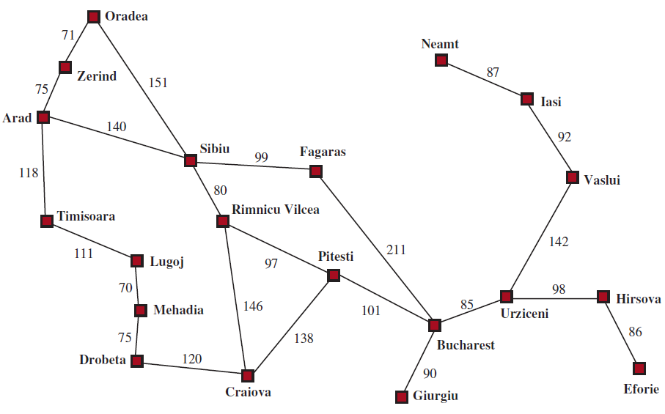
PROBLEM SOLVING AGENTS
Figure 3.1: A simplified road map of part of Romania, with road distances in miles.

Slide 7
PROBLEM SOLVING AGENTS
Imagine an agent enjoying a touring vacation in Romania. The agent wants to reach Bucharest from the current city Arad.
The agent observes street signs and sees that there are three roads leading out of Arad: one toward Sibiu, one to Timisoara, and one to Zerind.
None of these are the goal, so unless the agent is familiar with the geography of Romania, it will not know which road to follow

Slide 8
Problem Solving Steps
Assume our agents always have access to information about the world, such as the map in Figure 3.1. With that information, the agent can follow this four-phase problem-solving process:
Goal formulation: Goals organize behavior by limiting the objectives and hence the actions to be considered.
Problem formulation: The agent devises a description of the states and actions necessary to reach the goal—an abstract model of the relevant part of the world. For our agent, one good model is to consider the actions of traveling from one city to an adjacent city, and therefore the only fact about the state of the world that will change due to an action is the current city.

Slide 9
Problem Solving Steps
Search: Before taking any action in the real world, the agent simulates sequences of actions in its model, searching until it finds a sequence of actions that reaches the goal. Such a sequence is called a solution. The agent might have to simulate multiple sequences that do not reach the goal, but eventually it will find a solution (such as going from Arad to Sibiu to Fagaras to Bucharest), or it will find that no solution is possible..
Execution: The agent can now execute the actions in the solution, one at a time.

Slide 10
Open Loop vs Closed Loop
It is an important property that in a fully observable, deterministic, known environment, the solution to any problem is a fixed sequence of actions: drive to Sibiu, then Fagaras, then Bucharest.
If the model is correct, then once the agent has found a solution, it can ignore its percepts while it is executing the actions—closing its eyes, so to speak—because the solution is guaranteed to lead to the goal. Control theorists call this an open-loop system: ignoring the percepts breaks the loop between agent and environment.
If there is a chance that the model is incorrect, or the environment is nondeterministic, then the agent would be safer using a closed-loop approach that monitors the percepts.

Slide 11
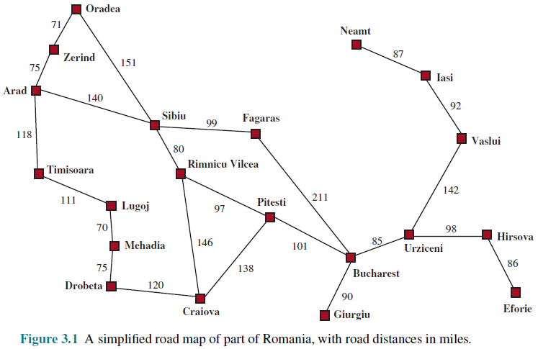
ROMANIAN MAP

Slide 12
Search problems and solutions
A search problem can be defined formally as follows:
A set of possible states that the environment can be in. We call this the state space.
The initial state that the agent starts in. For example: Arad.
A set of one or more goal states. Sometimes there is one goal state (e.g., Bucharest), sometimes there is a small set of alternative goal states, and sometimes the goal is defined by a property that applies to many states (potentially an infinite number). We can account for all three of these possibilities by specifying an IS-GOAL method for a problem.

Slide 13
Search problems and solutions
The actions available to the agent. Given a state s, ACTIONS(s) returns a finite set of actions that can be executed in s. We say that each of these actions is applicable in s.
An example: ACTIONS(Arad) = {ToSibiu, ToTimisoara, ToZerindg}
A transition model, which describes what each action does. RESULT(s, a) returns the state that results from doing action a in state s. For example, RESULT(Arad, ToZerind) = Zerind.

Slide 14
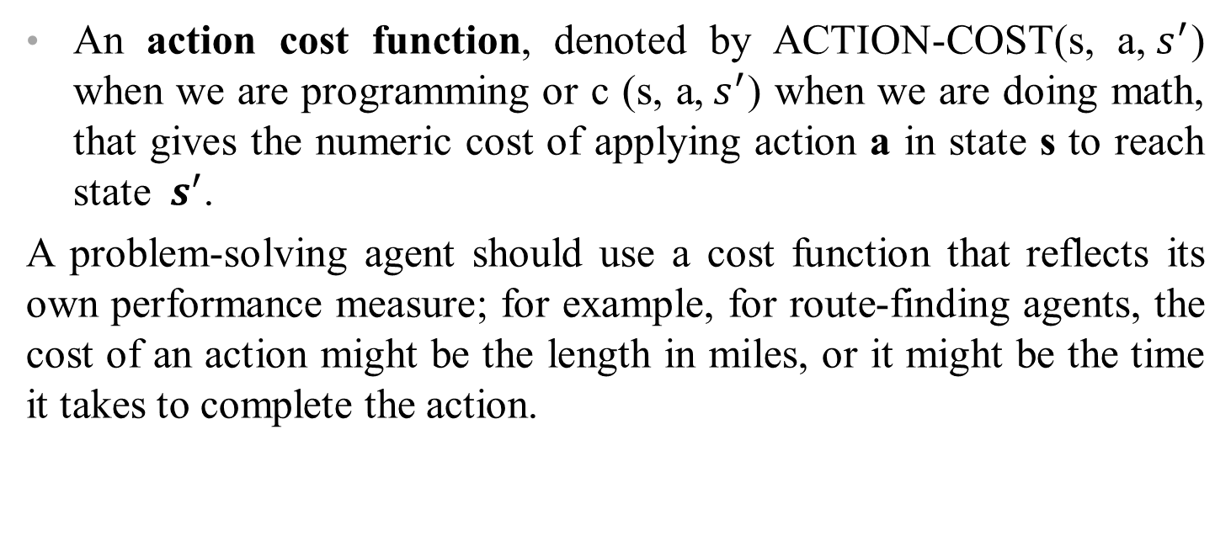
Search problems and solutions
An action cost function, denoted by ACTION-COST(s, a,${ s}^{′}$) when we are programming or c (s, a,${ s}^{′}$) when we are doing math, that gives the numeric cost of applying action a in state s to reach state ${ s}^{′}$.
A problem-solving agent should use a cost function that reflects its own performance measure; for example, for route-finding agents, the cost of an action might be the length in miles, or it might be the time it takes to complete the action.

Slide 15
Search problems and solutions
A sequence of actions forms a path, and a solution is a path from the initial state to a goal state.
We assume that action costs are additive; that is, the total cost of a path is the sum of the individual action costs.
An optimal solution has the lowest path cost among all solutions
The state space can be represented as a graph in which the vertices are states and the directed edges between them are actions. The map of Romania shown in Figure 3.1 is such a graph, where each road indicates two actions, one in each direction.

Slide 16
SEARCH-SOLUTION-EXECUTE
The process of looking for a sequence of actions that reaches the goal is called search.
Solution is the sequence of actions that takes any agent to the goal state, exactly those state the agent is satisfied.
A search algorithm takes a problem as input and returns a solution in the form of an action sequence.

Slide 17
WELL-DEFINED PROBLEMS
A problem can be defined formally by Six components:
States
Initial state
Actions
Transition model
Goal states
Action cost

Slide 18
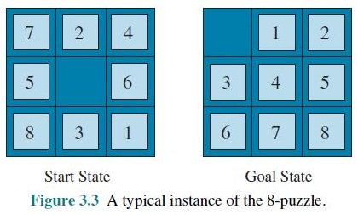
8-PUZZLE: PROBLEM FORMULATION

Slide 19
8-PUZZLE: PROBLEM FORMULATION
States: A state description specifies the location of each of the tiles.
Initial state: Any state can be designated as the initial state.
Actions: While in the physical world it is a tile that slides, the simplest way of describing an action is to think of the blank space moving Left, Right, Up or Down. If the blank is at an edge or corner then not all actions will be applicable.

Slide 20
8-PUZZLE: PROBLEM FORMULATION
Transition model: Maps a state and action to a resulting state; for example, if we apply Left to the start state in Figure 3.3, the resulting state has the 5 and the blank switched.
Goal state: Although any state could be the goal, we typically specify a state with the numbers in order, as in Figure 3.3.
Action cost: Each action costs 1.

Slide 21
SEARCHING FOR SOLUTIONS
A search algorithm takes a search problem as input and returns a solution, or an indication of Search algorithm failure.
A solution is an action sequence, so search algorithms work by considering various possible action sequences.
The possible action sequences starting at the initial state form a search tree with the initial state at the root; the branches are actions, and the nodes correspond to states in the state space of the problem.
Expanding the current state is, applying each legal action to the current state, thereby generating a new set of states

Slide 22
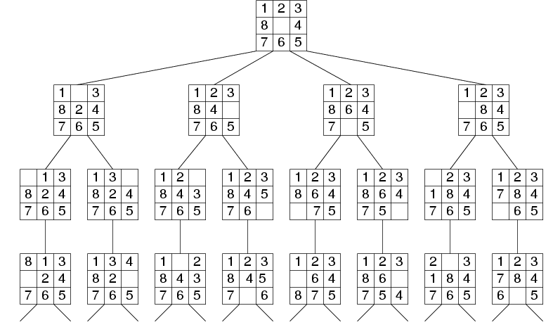
8-PUZZLE: Search Tree

Slide 23
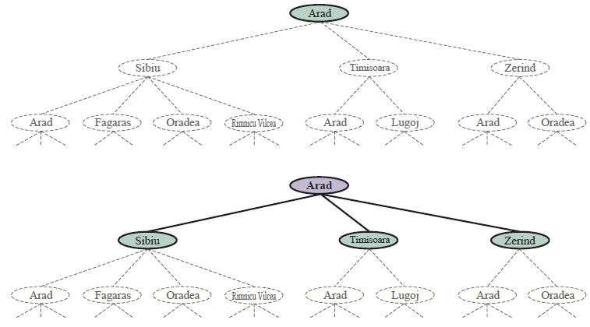
SEARCH TREE

Slide 24
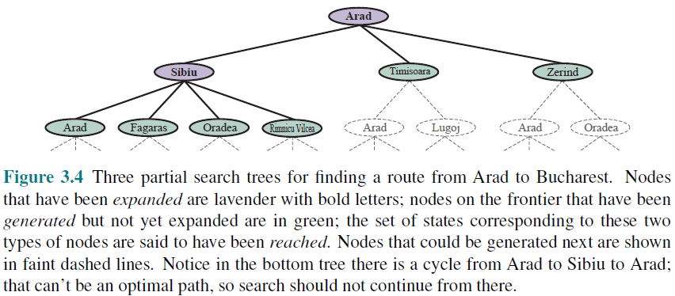
SEARCH TREE

Slide 25
SEARCH STRATEGY
the essence of search—following up one option now and putting the others aside for later, in case the first choice does not lead to a solution.
The set of all leaf nodes available for expansion at any given point is called the frontier.
The process of expanding nodes on the frontier continues until either a solution is found or there are no more states to expand.
Search algorithms all share this basic structure; they vary primarily according to how they choose which state to expand next —the so-called search strategy.

Slide 26
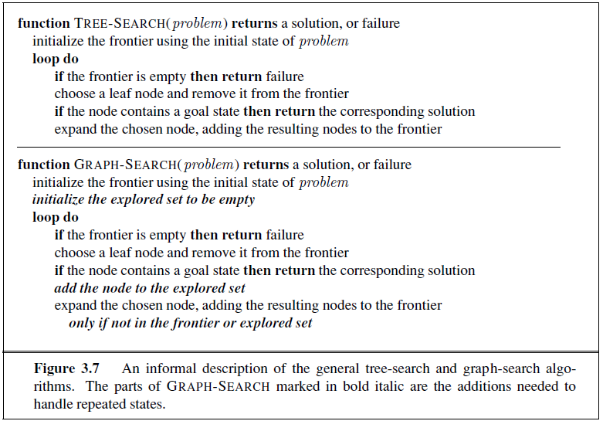
TREE SEARCH / GRAPH SEARCH

Slide 27
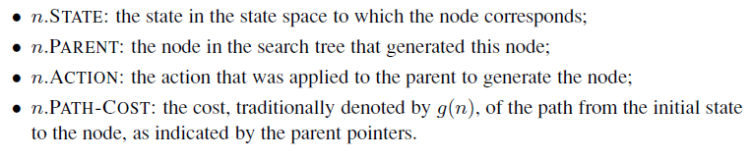
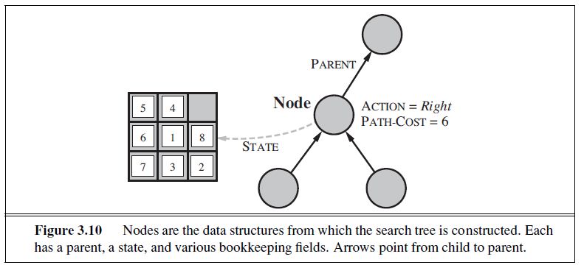
INFRASTRUCTURE FOR SEARCH ALGORITHMS

Slide 28
FRONTIER [FRINGE]
The frontier needs to be stored in such a way that the search algorithm can easily choose the next node to expand according to its preferred strategy. The appropriate data structure for this is a queue.
The operations on a queue are as follows:
• EMPTY(queue) returns true only if there are no more elements in the queue.
• POP(queue) removes the first element of the queue and returns it.
• INSERT(element, queue) inserts an element and returns the resulting queue.
Queues are characterized by the order in which they store the inserted nodes. Three common variants are -
the first-in, first-out For FIFO queue, which pops the oldest element of the queue;
the last-in, first-out or LIFO queue (also known as a stack), which pops the newest element of the queue; and
the priority queue,

Slide 29
MEASURING PROBLEM-SOLVING PERFORMANCE
We can evaluate an algorithm’s performance in four ways:
Completeness: Is the algorithm guaranteed to find a solution when there is one, and to correctly report failure when there is not?
Cost optimality: Does it find a solution with the lowest path cost of all solutions?
Time complexity: How long does it take to find a solution? This can be measured in seconds, or more abstractly by the number of states and actions considered.
Space complexity: How much memory is needed to perform the search?

Slide 30
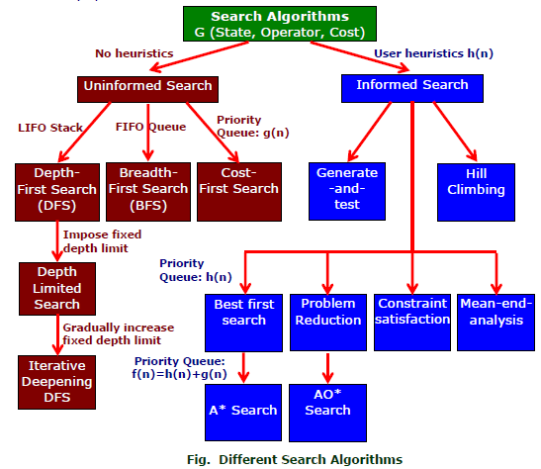
SEARCH ALGORITHMS

Slide 31
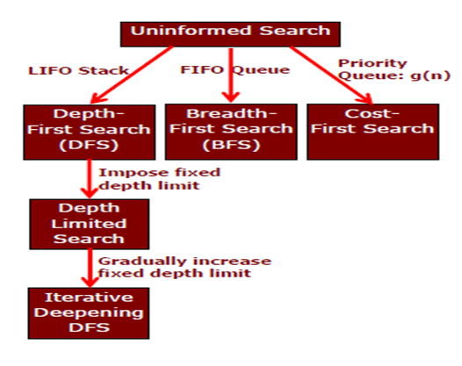
UNINFORMED SEARCH STRATEGIES

Slide 32
BREADTH-FIRST SEARCH
Breadth-first search is a simple strategy in which the root node is expanded first, then all the successors of the root node are expanded next, then their successors, and so on.
In general, all the nodes are expanded at a given depth in the search tree before any nodes at the next level are expanded.
Breadth-first search is an instance of the general graph-search algorithm (Figure 3.7) in which the shallowest unexpanded node is chosen for expansion.
This is achieved very simply by using a FIFO queue for the frontier.
Thus, new nodes (which are always deeper than their parents) go to the back of the queue, and old nodes, which are shallower than the new nodes, get expanded first.
The goal test is applied to each node when it is generated rather than when it is selected for expansion.
Following the general template for graph search, discards any new path to a state already in the frontier or explored set

Slide 33
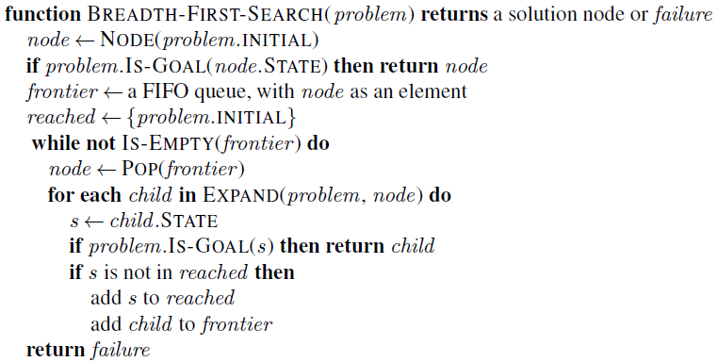
BREADTH-FIRST SEARCH: PSEUDOCODE

Slide 34
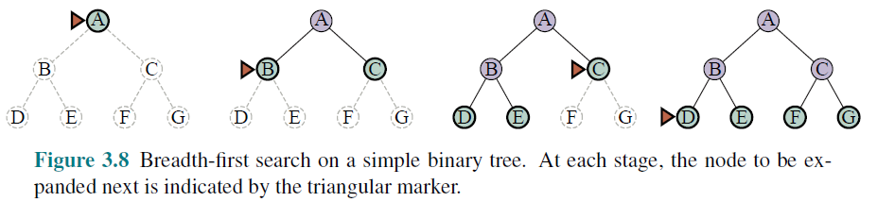

BREADTH-FIRST SEARCH: FOUR CRITERIA
complete—if the shallowest goal node is at some finite depth d, breadth-first search will eventually find it after generating all shallower nodes.
Breadth-first search is optimal if the path cost is a non-decreasing function of the depth of the node.
The time complexity would be O(b^{d+1}), The space complexity is O(b^{d})
For uniform tree, the total number of nodes generated is

Slide 35
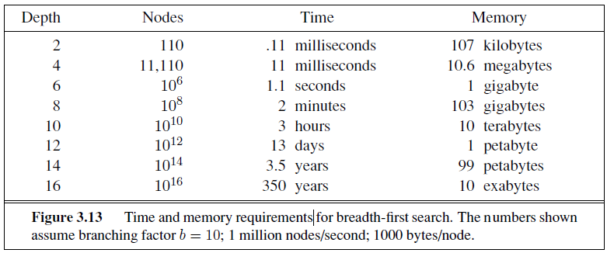
BREADTH-FIRST SEARCH: MEMORY REQUIREMENTS

Slide 36
DEPTH-FIRST SEARCH
Depth-first search always expands the deepest node in the current frontier of the search tree.
The search proceeds immediately to the deepest level of the search tree, where the nodes have no successors
As those nodes are expanded, they are dropped from the frontier, so then the search “backs up” to the next deepest node that still has unexplored successors.
The depth-first search algorithm is an instance of the graph-search algorithm, where it uses a LIFO queue

Slide 37
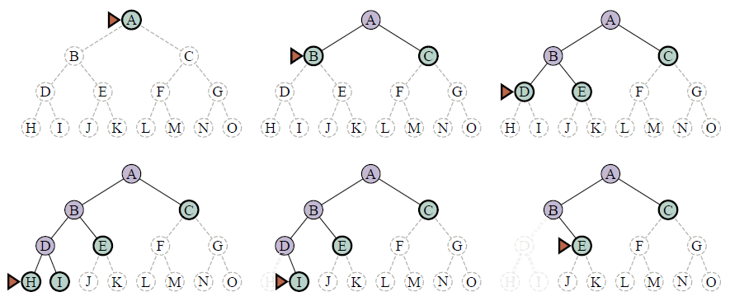
DEPTH-FIRST SEARCH: SEARCH TREE

Slide 38
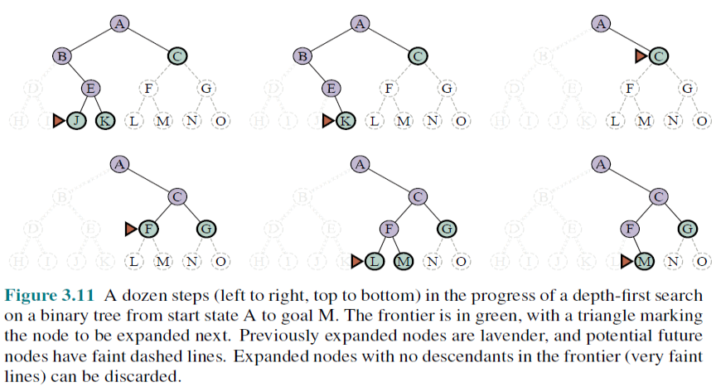
DEPTH-FIRST SEARCH: SEARCH TREE

Slide 39
DEPTH-FIRST SEARCH: Optimality, Complexity, Completeness
The graph-search version is complete in finite state spaces because it will eventually expand every node. The tree-search version, on the other hand, is not complete
Both versions are nonoptimal. For example, in Figure 3.16, depth first search will explore the entire left subtree even if node C is a goal node. If node J were also a goal node, then depth-first search would return it as a solution instead of C, which would be a better solution; hence, depth-first search is not optimal.
A depth-first tree search, may generate all of the O(b^{m}) nodes in the search tree, where m is the maximum depth of any node; this can be much greater than the size of the state space.
For a state space with branching factor b and maximum depth m, depth-first search requires storage of only O(bm) nodes.

Slide 40
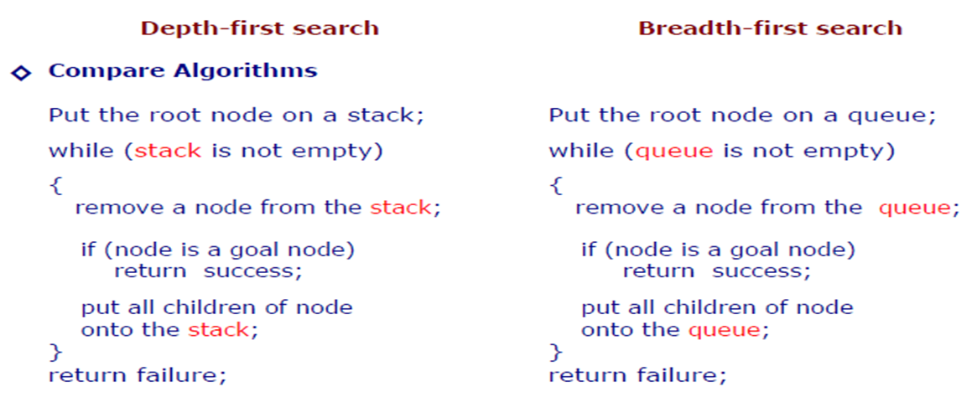
DFS v/s BFS

Slide 41
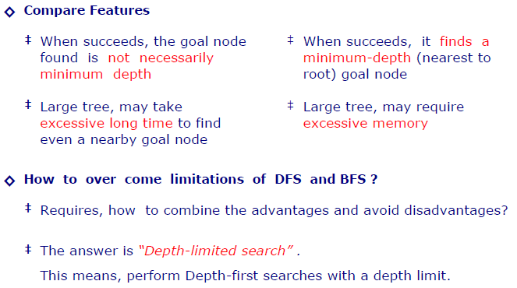
DFS v/s BFS

Slide 42
DEPTH-LIMITED SEARCH
The embarrassing failure of depth-first search in infinite state spaces can be alleviated by supplying depth-first search with a predetermined depth limit .
That is, nodes at depth are treated as if they have no successors.
This approach is called depth-limited search
Depth-limited search will also be nonoptimal if we choose l> d. Its time complexity is O(b^{l}) and its space complexity is O(bl).
Depth-first search can be viewed as a special case of depth-limited search with l=∞.

Slide 43
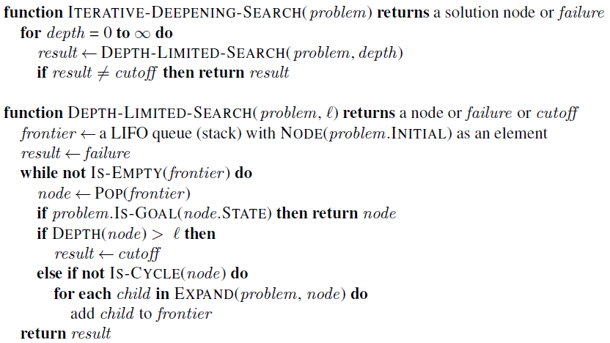
DEPTH-LIMITED SEARCH: PSEUDOCODE

Slide 44
ITERATIVE DEEPENING DEPTH-FIRST SEARCH
Iterative deepening search (or iterative deepening depth-first search) is a general strategy, often used in combination with depth-first tree search, that finds the best depth limit.
It does this by gradually increasing the limit—first 0, then 1, then 2, and so on—until a goal is found
Iterative deepening combines the benefits of depth-first and breadth-first search.
Like depth-first search, its memory requirements are modest: O(bd) to be precise.
Like breadth-first search, it is complete when the branching factor is finite and optimal when the path cost is a nondecreasing function of the depth of the node

Slide 45
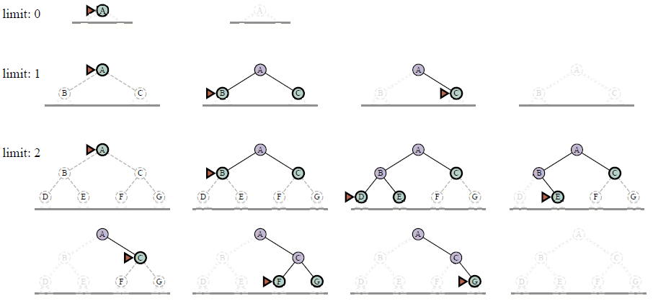
ITERATIVE DEEPENING DEPTH-FIRST SEARCH TREE

Slide 46
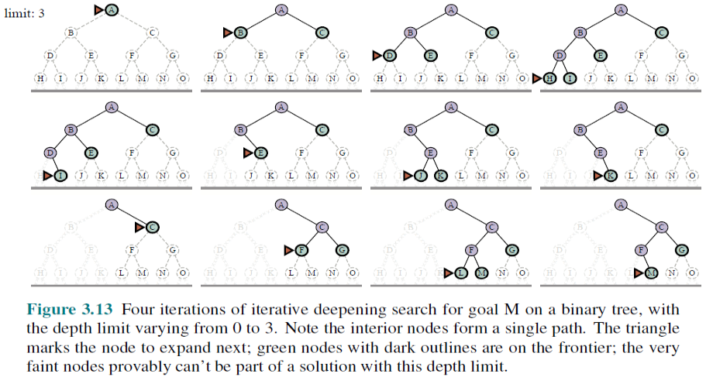
ITERATIVE DEEPENING DEPTH-FIRST SEARCH TREE

Slide 47

IDP: COMPLEXITY
Iterative deepening search may seem wasteful because states are generated multiple times. It turns out this is not too costly.
The reason is that in a search tree with the same (or nearly the same) branching factor at each level, most of the nodes are in the bottom level, so it does not matter much that the upper levels are generated multiple times.
In an iterative deepening search, the nodes on the bottom level (depth d) are generated once, those on the next-to-bottom level are generated twice, and so on, up to the children of the root, which are generated d times.
So the total number of nodes generated in the worst case is

Slide 48
UNIFORM-COST SEARCH
Instead of expanding the shallowest node, uniform-cost search expands the node n with the lowest path cost g(n).
This is done by storing the frontier as a priority queue ordered by g
Two other significant differences from breadth-first search are
The goal test is applied to a node when it is selected for expansion rather than when it is first generated
A test is added in case a better path is found to a node currently on the frontier.

Slide 49
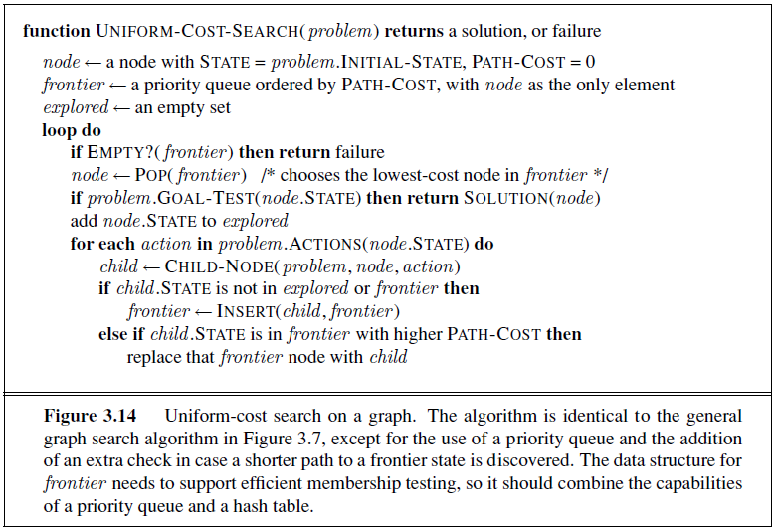
UNIFORM-COST SEARCH: PSEUDOCODE

Slide 50
UNIFORM-COST SEARCH: PSEUDOCODE

Slide 51
UNIFORM-COST SEARCH: Arad → Bucharest
0
Arad
Arad
140
75
118
Sibiu
Timisoara
Sibiu
Zerind
Timisoara
Zerind
291
146
229
Oradea
Lugoj
Oradea
Lugoj
Oradea
Oradea
220
Rimnicu
Rimnicu
317
299
Mehadia
239
366
Mehadia
Pitesti
Fagaras
Pitesti
Fagaras
Craiova
Craiova
374
418
Drobeta
450
455
Bucharest
Drobeta
Bucharest
Bucharest
Craiova
486
Drobeta

Slide 52
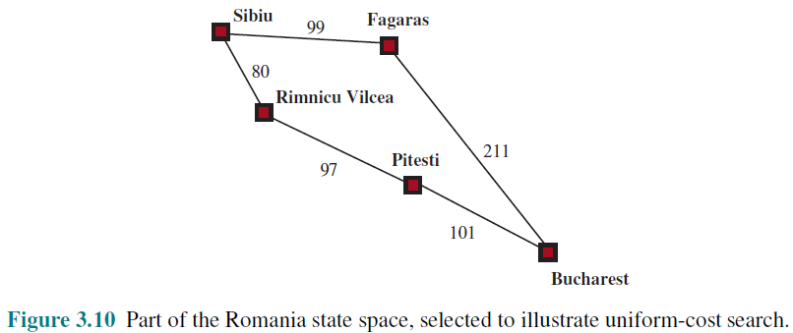
UNIFORM-COST SEARCH: ILLUSTRATION

Slide 53
UNIFORM-COST SEARCH: OPTIMALITY
Observe that whenever uniform-cost search selects a node n for expansion, the optimal path to that node has been found.
Were this not the case, there would have to be another frontier node n’ on the optimal path from the start node to n, n’ would have lower g-cost than n and would have been selected first
Then, because step costs are nonnegative, paths never get shorter as nodes are added
These two facts together imply that
uniform-cost search expands nodes in order of their optimal path cost.
Hence, the first goal node selected for expansion must be the optimal solution.

Slide 54
UNIFORM-COST SEARCH: COMPLETENESS & COMPLEXITY
Completeness is guaranteed provided the cost of every step exceeds some small positive constant ε.
Uniform-cost search is guided by path costs rather than depths, so its complexity is not easily characterized in terms of b and d.
Instead, let C* be the cost of the optimal solution, and assume that every action costs at least ε .
Then the algorithm’s worst-case time and space complexity is O(b ^{1+[C*/ε]}), which can be much greater than b^{d}.
When all step costs are equal, b ^{1+ [C∗/ε]} is just b^{d+1}.

Slide 55
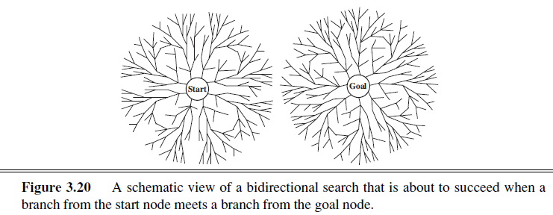
BIDIRECTIONAL SEARCH
The idea behind bidirectional search is to run two simultaneous searches—one forward from the initial state and the other backward from the goal—hoping that the two searches meet in the middle
Bidirectional search is implemented by replacing the goal test with a check to see whether the frontiers of the two searches intersect;

Slide 56
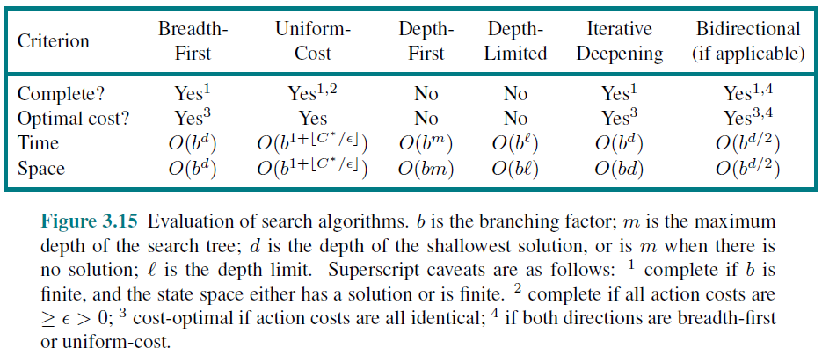
COMPARING UNINFORMED SEARCH STRATEGIES
This comparison is for tree-like search versions which don’t check for repeated states. For graph searches which do check, the main differences are that depth-first search is complete for finite state spaces.

Slide 57
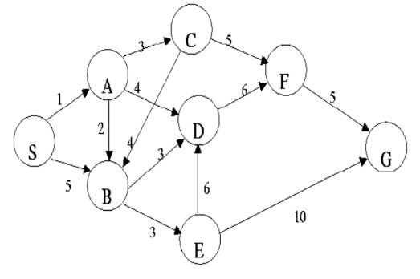
Example (Simulation)
Consider S is the starting state, and G is the goal state in the graph. The step costs are given in the edges.
Construct the search tree to find a path from the start state S to the goal state G using BFS, DFS and UCS search for the given graph.
Clearly mention the expand sequence and, path with the path cost.

Slide 58
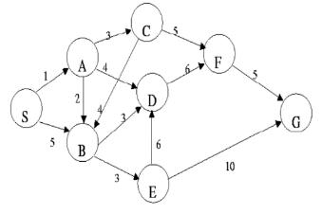
Example (BFS)
Expanded Node List
Empty
Queue
S
As we aim to find a path from node S to node G, the queue will contain the starting node (S) by default, unless the starting node itself is the goal state.
If S is not the goal, the search will continue by exploring neighboring nodes, expanding them, and adding paths to the queue until the goal node (G) is found.

Slide 59

Example (BFS)
Expanded Node List
S
S
Queue
S $×$
S-A
S-B
A
B
In BFS, we check if a node is the goal as soon as it's generated. If it's the goal node, we stop. If not, we add the path leading to that node into the queue.
For example, starting at S, A is generated first. Since A is not the goal, we add the path S-A to the queue. Next, B is generated and the path S-B is also added to the queue.
Note that when we choose S, it is removed from the queue. So, the queue now only has the paths S-A and S-B.
Additionally, node A is added to the list of expanded nodes because it has just been processed.

Slide 60
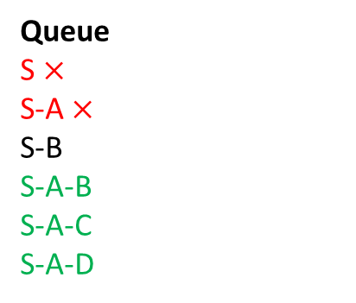
Example (BFS)
Expanded Node List
S, A
S
Queue
S $×$
S-A $×$
S-B
S-A-B
S-A-C
S-A-D
A
B
B
C
D
After expanding nodes S and A, we have 4 paths in the queue: S-B, S-A-B, S-A-C, and S-A-D. Since BFS follows a queue (FIFO) behavior, the next path to be expanded will be the first one in the queue, which is S-B.

Slide 61

Example (BFS)
Expanded Node List
S, A, B
S
Queue
S $×$
S-A $×$
S-B $×$
S-A-B
S-A-C
S-A-D
S-B-D
S-B-E
A
B
B
C
D
D
E
After expanding the nodes S, A, and B, we have 5 paths in the queue: S-A-B, S-A-C, S-A-D, S-B-D, and S-B-E. Since BFS follows a queue (FIFO) behavior, the next path to be expanded will be the first one in the queue, which is S-A-B.

Slide 62

Example (BFS)
Expanded Node List
S, A, B, C
S
Queue
S $×$
S-A $×$
S-B $×$
S-A-B $×$
S-A-C $×$
S-A-D
S-B-D
S-B-E
S-A-C-F
A
B
B
C
D
D
E
F
In this case, S-A-B is selected but not expanded because node B has already been expanded. Next, S-A-C is selected and expanded. From node C, node B will not be generated because it has already been expanded.
In Graph-like Search, once a node is expanded, it is not considered for further expansion or generation. This helps to avoid revisiting already processed nodes.

Slide 63

Example (BFS)
Expanded Node List
S, A, B, C, D
S
Queue
S $×$
S-A $×$
S-B $×$
S-A-B $×$
S-A-C $×$
S-A-D $×$
S-B-D
S-B-E
S-A-C-F
S-A-D-F
A
B
B
C
D
D
E
F
F

Slide 64

Example (BFS)
Expanded Node List
S, A, B, C, D, E
S
Queue
S $×$
S-A $×$
S-B $×$
S-A-B $×$
S-A-C $×$
S-A-D $×$
S-B-D $×$
S-B-E $×$
S-A-C-F
S-A-D-F
A
B
B
C
D
D
E
F
F
G
In this scenario, S-B-D is selected but not expanded because node D has already been expanded. Then, S-B-E is selected and expanded. From node E, node D will not be generated since D has already been expanded.
In BFS, as soon as the goal node is generated, we stop. Here, when node E is expanded, the goal node G is generated. Since the goal test is satisfied, there is no need to insert the path (S-B-E-G) into the queue. The search stops immediately after generating the goal node.

Slide 65
Example (BFS)
Expanded Node List
S, A, B, C, D, E
S
Queue
S $×$
S-A $×$
S-B $×$
S-A-B $×$
S-A-C $×$
S-A-D $×$
S-B-D $×$
S-B-E $×$
S-A-C-F
S-A-D-F
A
B
B
C
D
D
E
F
F
G
So, the result of the BFS is the path S-B-E-G which cost is 18
Remember: In BFS, we can never find a better path to a state that has just been generated or reached. This means we can perform an early goal test, checking whether a node is a solution as soon as it is generated. This differs from the late goal test used by other search algorithms, which wait until a node is removed from the frontier (selected for expansion) to check if it is a solution.

Slide 66
Example (DFS)
Expanded Node List
Empty
Stack
S
As we aim to find a path from node S to node G, the stack (LIFO queue) will contain the starting node (S) by default.
The search will continue by exploring neighboring nodes, expanding them, and adding paths to the queue until the goal node (G) is selected for expanding.

Slide 67
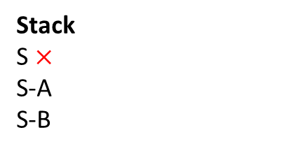
Example (DFS)
Expanded Node List
S
S
Stack
S $×$
S-A
S-B
A
B
In DFS, we do not check if a node is the goal as soon as it is generated. Instead, the goal test is performed when a node is selected for expansion.
For example, when expanding node S and generating A and B, the goal test is not performed for A or B. Instead, the goal test is applied to S during its expansion.
If the goal test is satisfied for the selected node, we stop the search immediately and do not proceed with expanding that node.

Slide 68
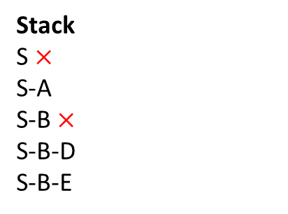
Example (DFS)
Expanded Node List
S, B
S
Stack
S $×$
S-A
S-B $×$
S-B-D
S-B-E
A
B
D
E
Since DFS follows LIFO (Last In, First Out) behavior, the most recently generated node is selected first. In this case, starting from S, node A is generated first, followed by node B. As a result, the path S-B will be selected for expansion before S-A.
Notice that after expanding S-B, we have a total of three paths in the stack: S-A, S-B-D, and S-B-E. Since DFS follows LIFO behavior, the most recently generated path, S-B-E, will be selected next for expansion.

Slide 69

Example (DFS)
Expanded Node List
S, B, E
S
Stack
S $×$
S-A
S-B $×$
S-B-D
S-B-E $×$
S-B-E-D
S-B-E-G
A
B
D
E
D
G
We won't stop here just because G has been generated. In DFS and other algorithms, we continue exploring until the goal node is selected. The search will only stop when the goal node is selected for expansion and the goal test is satisfied.

Slide 70


Example (DFS)
Expanded Node List
S, B, E
S
Stack
S $×$
S-A
S-B $×$
S-B-D
S-B-E $×$
S-B-E-D
S-B-E-G $×$
A
B
D
E
D
G
Now that the goal node G is selected and the goal test is satisfied, we stop the search. The resulting path is S-B-E-G, with a cost of 18.
Although we obtained the same path (S-B-E-G) in this case, it's important to note that the path can be different for BFS and DFS. This difference arises because BFS explores nodes level by level, while DFS explores as deep as possible along each branch.

Slide 71
Example (DFS)
Expanded Node List
S, B, E
S
Stack
S $×$
S-A
S-B $×$
S-B-D
S-B-E $×$
S-B-E-D
S-B-E-G $×$
A
B
D
E
D
G
It is not required to add G to the expanded list since it was not expanded; it was only selected.
In DFS (and BFS), nodes are added to the expanded list only when they are actually expanded, not when they are selected.
Since the goal node G was selected and the goal test was satisfied, there was no need to expand it further, so it is not added to the expanded list.

Slide 72
Example (UCS)
Expanded Node List
Empty
Priority Queue
S (0)
As we aim to find a path from node S to node G, the priority queue will initially contain the starting node (S) by default. In this case, we must also store the path cost associated with each node, as it will be used as the priority value to determine the order in which nodes are expanded.
The search will continue by exploring neighboring nodes, expanding them, and adding paths to the queue until the goal node (G) is selected for expanding.

Slide 73
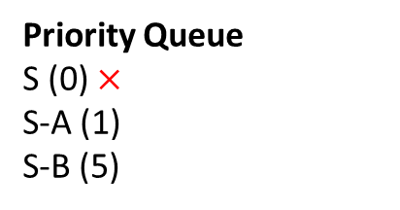
Example (UCS)
Expanded Node List
S
S,0
Priority Queue
S (0) $×$
S-A (1)
S-B (5)
A,1
B,5
In UCS, we do not check if a node is the goal as soon as it is generated. Instead, the goal test is performed when a node is selected for expansion.
For example, when expanding node S and generating A and B, the goal test is not performed for A or B. Instead, the goal test is applied to S during its expansion.
If the goal test is satisfied for the selected node, we stop the search immediately and do not proceed with expanding that node.

Slide 74
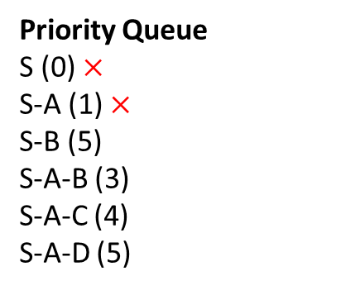
Example (UCS)
Expanded Node List
S, A
S,0
Priority Queue
S (0) $×$
S-A (1) $×$
S-B (5)
S-A-B (3)
S-A-C (4)
S-A-D (5)
A,1
B,5
B,3
C,4
D,5
Now, each path in the priority queue for UCS (Uniform Cost Search) includes a priority value, which is the path cost from the starting node to the current node.
For example, when node A is generated from S, the path cost of 1 is stored. Similarly, for S-B, the path cost of 5 is stored.
The path with the highest priority (i.e., the lowest path cost) is selected first. In this case, the path S-A, with a cost of 1, is selected before S-B, which has a cost of 5.

Slide 75
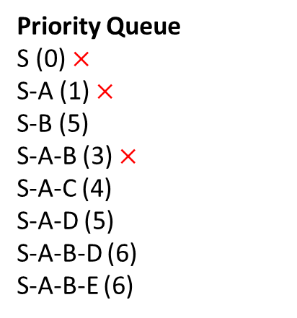
Example (UCS)
Expanded Node List
S, A, B
S,0
Priority Queue
S (0) $×$
S-A (1) $×$
S-B (5)
S-A-B (3) $×$
S-A-C (4)
S-A-D (5)
S-A-B-D (6)
S-A-B-E (6)
A,1
B,5
B,3
C,4
D,5
D,6
E,6
There were 4 paths in the priority queue: S-B, S-A-B, S-A-C, and S-A-D. However, the path with the lowest cost, S-A-B (cost 3), was selected for expansion. From node B, nodes D and E were generated.
Notice that D was generated twice. There is no restriction on generating a node multiple times. However, in graph-like search, once a node is expanded, it cannot be generated or expanded again. This ensures that already processed nodes are not revisited, avoiding redundant work.

Slide 76
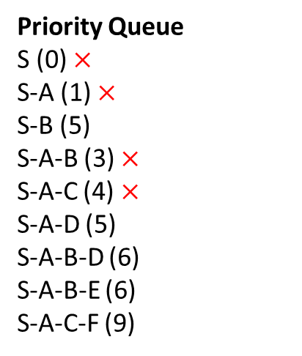
Example (UCS)
Expanded Node List
S, A, B, C
S,0
Priority Queue
S (0) $×$
S-A (1) $×$
S-B (5)
S-A-B (3) $×$
S-A-C (4) $×$
S-A-D (5)
S-A-B-D (6)
S-A-B-E (6)
S-A-C-F (9)
A,1
B,5
B,3
C,4
D,5
D,6
E,6
F,9
S-A-C is selected and expanded. From C, B was not generated as B is already expanded. Only F was generated.

Slide 77
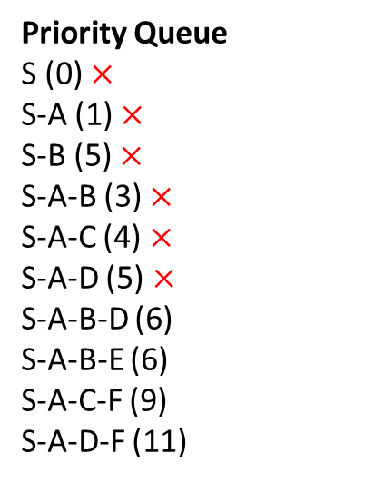
Example (UCS)
Expanded Node List
S, A, B, C, D
S,0
Priority Queue
S (0) $×$
S-A (1) $×$
S-B (5) $×$
S-A-B (3) $×$
S-A-C (4) $×$
S-A-D (5) $×$
S-A-B-D (6)
S-A-B-E (6)
S-A-C-F (9)
S-A-D-F (11)
A,1
B,5
B,3
C,4
D,5
D,6
E,6
F,9
F,11
In this step, we had two paths with the lowest path cost: S-A-B and S-A-D. However, S-B was initially selected. Since S-B had already been expanded, it could not be expanded again.
As a result, we then selected S-A-D and proceeded to expand it. This highlights that in such cases, the algorithm moves on to the next valid path in the priority queue if the selected path cannot be expanded.

Slide 78
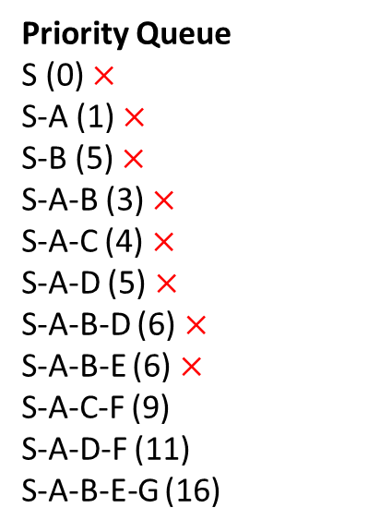
Example (UCS)
Expanded Node List
S, A, B, C, D, E
S,0
Priority Queue
S (0) $×$
S-A (1) $×$
S-B (5) $×$
S-A-B (3) $×$
S-A-C (4) $×$
S-A-D (5) $×$
S-A-B-D (6) $×$
S-A-B-E (6) $×$
S-A-C-F (9)
S-A-D-F (11)
S-A-B-E-G (16)
A,1
B,5
B,3
C,4
D,5
D,6
E,6
F,9
F,11
G,16
Similarly, S-A-B-D was selected but could not be expanded because the node D had already been expanded.
Next, S-A-B-E was selected and expanded. During this expansion, the goal node G was generated. However, we do not stop here because the algorithm continues until the goal node G is selected for expansion.

Slide 79
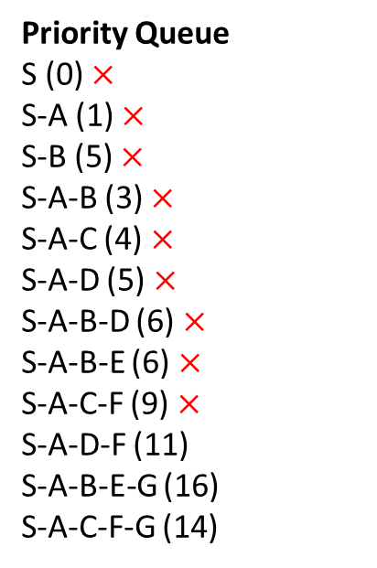
Example (UCS)
Expanded Node List
S, A, B, C, D, E, F
S,0
Priority Queue
S (0) $×$
S-A (1) $×$
S-B (5) $×$
S-A-B (3) $×$
S-A-C (4) $×$
S-A-D (5) $×$
S-A-B-D (6) $×$
S-A-B-E (6) $×$
S-A-C-F (9) $×$
S-A-D-F (11)
S-A-B-E-G (16)
S-A-C-F-G (14)
A,1
B,5
B,3
C,4
D,5
D,6
E,6
F,9
F,11
G,16
G,14
Similarly, we have selected S-A-C-F and expanded it.

Slide 80
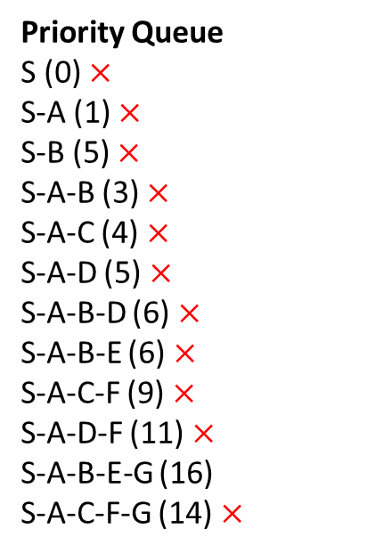
Example (UCS)
Expanded Node List
S, A, B, C, D, E, F
S,0
Priority Queue
S (0) $×$
S-A (1) $×$
S-B (5) $×$
S-A-B (3) $×$
S-A-C (4) $×$
S-A-D (5) $×$
S-A-B-D (6) $×$
S-A-B-E (6) $×$
S-A-C-F (9) $×$
S-A-D-F (11) $×$
S-A-B-E-G (16)
S-A-C-F-G (14) $×$
A,1
B,5
B,3
C,4
D,5
D,6
E,6
F,9
F,11
G,16
G,14
Now, S-A-D-F was selected but could not be expanded as node F had already been expanded.
Next, S-A-C-F-G was selected. The goal test is satisfied, so the search stops here.

Slide 81

Example (UCS)
Expanded Node List
S, A, B, C, D, E, F
S,0
Priority Queue
S (0) $×$
S-A (1) $×$
S-B (5) $×$
S-A-B (3) $×$
S-A-C (4) $×$
S-A-D (5) $×$
S-A-B-D (6) $×$
S-A-B-E (6) $×$
S-A-C-F (9) $×$
S-A-D-F (11) $×$
S-A-B-E-G (16)
S-A-C-F-G (14) $×$
A,1
B,5
B,3
C,4
D,5
D,6
E,6
F,9
F,11
G,16
G,14
It can be observed that UCS (Uniform Cost Search) has successfully found the optimal path, which is the path with the lowest cost.
This is because UCS expands nodes in order of their path cost, ensuring that the goal node selected first is on the least-cost path.

Slide 82
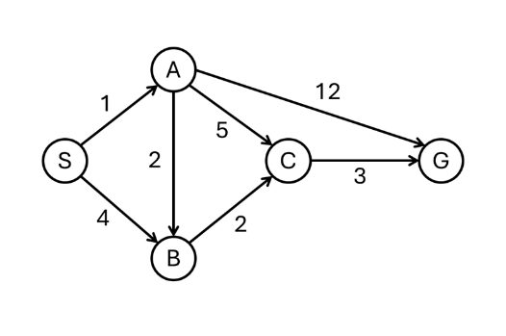
Exercise
Consider S is the starting state, and G is the goal state in the graph. The step costs are given in the edges.
Construct the search tree to find a path from the start state S to the goal state G using BFS, DFS and IDS search for the given graph.
Clearly mention the expand sequence and, path with the path cost.

Slide 83
References
Chapter 3: Solving Problem by Searching , Pages 64-91
“Artificial Intelligence: A Modern Approach,” by Stuart J. Russell and Peter Norvig,

Slide 84
Books
“Artificial Intelligence: A Modern Approach,” by Stuart J. Russell and Peter Norvig.
"Artificial Intelligence: Structures and Strategies for Complex Problem Solving", by George F. Luger, (2002)
"Artificial Intelligence: Theory and Practice", by Thomas Dean.
"AI: A New Synthesis", by Nils J. Nilsson.
“Programming for machine learning,” by J. Ross Quinlan,
“Neural Computing Theory and Practice,” by Philip D. Wasserman, .
“Neural Network Design,” by Martin T. Hagan, Howard B. Demuth, Mark H. Beale, .
“Practical Genetic Algorithms,” by Randy L. Haupt and Sue Ellen Haupt.
“Genetic Algorithms in Search, optimization and Machine learning,” by David E. Goldberg.
"Computational Intelligence: A Logical Approach", by David Poole, Alan Mackworth, and Randy Goebel.
“Introduction to Turbo Prolog”, by Carl Townsend.

